Slide 1
CS2033a/b Multimedia and Communications II Lecture 11 Content Management Systems
Wikis
Vivi Tryphonopoulos

Slide 2
Content Management Systems
Classic Scenario:
Goal: PR department →get a press release up on the Web
Write the release and get it approved
Send the release out on the wire.
Send the release to the Web group.
The Web group then converts the document to HTML and puts it on the Web site.
Most larger companies have some sort of staging server where Web documents sit until they are pushed live
If a press release has sensitive information, it can't be released to the Web group until it has been sent to the wire, but often upper management wants it on the Web site immediately.
Problems:
Stress.
Too many hoops.
Too many people involved.
Don’t know HTML
Solution:
Let PR do it themselves
Notes:
Available since 1996, but browser support was not there. With advent of CSS 2.0, and IE 6 Netsape 6+ Opera 6+), it has been more practical to use style sheets.

Slide 3
Content Management Systems
Case Scenario 2:
Goal: ABC Company →expand their $500 million company
Customers can’t find the product information
too deep
Pages managed by different groups.
Broken links.
Unfinished pages.
Group staff outsource in order to get better handle
Others keep it internal.
Scattered
Need change...
Manages their content effectively
When a page should get published
Standardization of all pages
Easy update
All information is available and accessible.
Solution:
Notes:
Available since 1996, but browser support was not there. With advent of CSS 2.0, and IE 6 Netsape 6+ Opera 6+), it has been more practical to use style sheets.

Slide 4
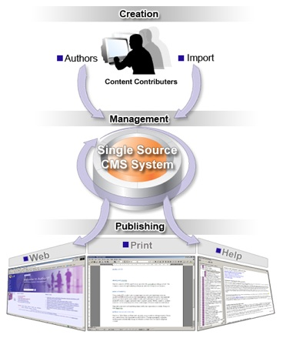
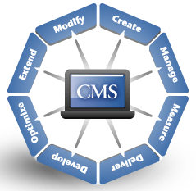
Content Management Systems
CMS Software:
Helps manage web sites and web content across a wider range in an organization.
Ease-simplicity
Consistency-same look
Control-immediate sharing
Notes:
Available since 1996, but browser support was not there. With advent of CSS 2.0, and IE 6 Netsape 6+ Opera 6+), it has been more practical to use style sheets.

Slide 5
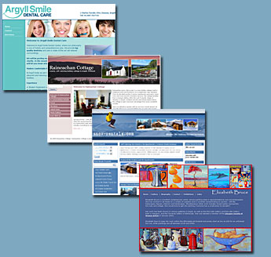
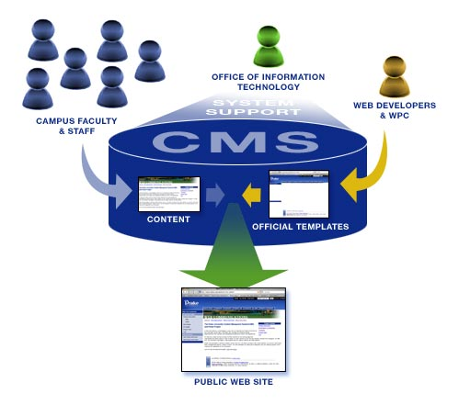
Content Management Systems
What is a Content Management System (CMS)
Also known as Web Management System
Software application used to create, customize, and manage information. – seamlessly
Used by large websites which include newspapers and governments.
Offers a web-based GUI
Access the CMS online using a browser – no need for DW copy on their system
Structured content management features
Can store: news documents, images, video and any other online content type imaginable
Great for sites with multiple editors and sections that need control
→foundation on many large websites which include newspapers and governments
Source: http://www.vdocs.org/index.php/document-management/content-management-system
Notes:
Available since 1996, but browser support was not there. With advent of CSS 2.0, and IE 6 Netsape 6+ Opera 6+), it has been more practical to use style sheets.

Slide 6
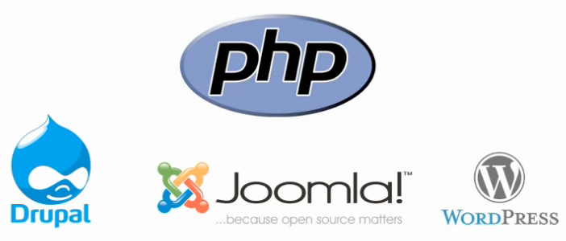
Content Management Systems
CMS History:
1995-2000
Explosion of proprietary software
→Developed by a single corporation and licensed to clients that wish to use it.
Customized for that client and workflow
Expensive $$$, and used by larger sites with big budgets
1998-2005
Release of PHP (mid 90s) free general purpose scripting language available for web development
Led to explosion of ________ systems
Lowered the cost of hosting dynamic websites
Explosion of CMS- easier for individuals to bring content management to their orgs
Open Source Software
Software designed to encourage collaboration and community development
Released with licenses for distribution for free and without royalty fees.
Notes:
Available since 1996, but browser support was not there. With advent of CSS 2.0, and IE 6 Netsape 6+ Opera 6+), it has been more practical to use style sheets.

Slide 7
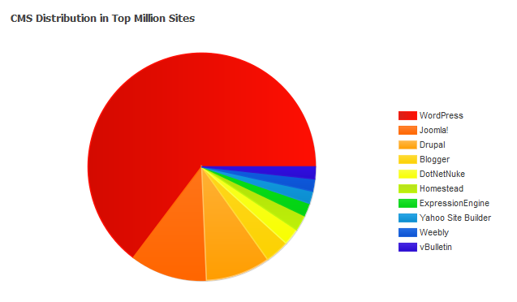
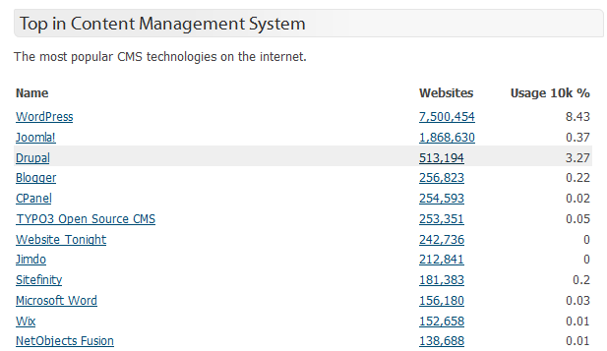
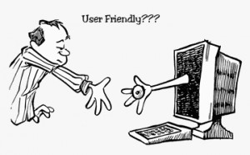
Content Management Systems
How are they set up?
Most CMS can be used alone, or in conjunction (integrated) with other applications.
Can be set up directly on a network, the Internet, or even to run "locally" on your own computer.
Most popular web CMS
WordPress :
Most popular CMS- originated for blogging only but now full fledged CMS
Joomla:
More complex than Wordpress.
Drupal:
Second most used CMS and originated before WordPress and Joomla.
Much more difficult to learn and understand
Most secure.
Top million sites – March 15_2013
http://trends.builtwith.com/cms
Notes:
Available since 1996, but browser support was not there. With advent of CSS 2.0, and IE 6 Netsape 6+ Opera 6+), it has been more practical to use style sheets.

Slide 8

Content Management Systems
Pros and Cons of Open Source CMS
(+)Most CMS can be used alone, or in conjunction (integrated) with other applications.
(+)Can be set up directly on a network, the Internet, or even to run "locally" on your own computer.
(+-)Technically-savvy users can download, install, and configure for free
(+-)Hosting companies offer 1-click install
(-)Significant time commitment to learn the 1-click intall CMS
Most Powerful and Best Open Source
http://ardorbacklinks.com/links/features-of-a-user-friendly-cms.html
Notes:
Available since 1996, but browser support was not there. With advent of CSS 2.0, and IE 6 Netsape 6+ Opera 6+), it has been more practical to use style sheets.

Slide 9
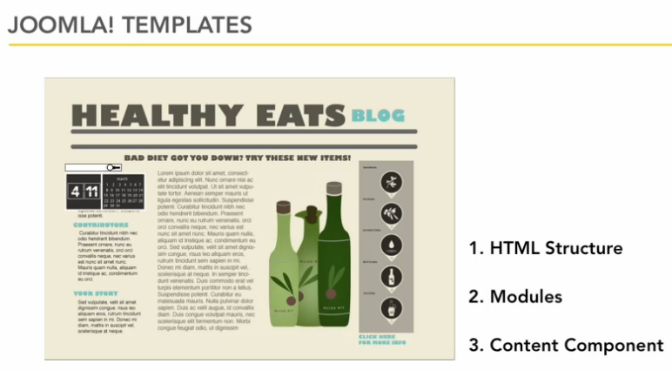
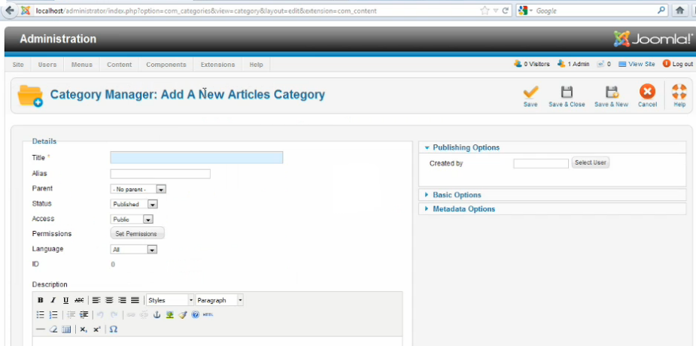
Content Management Systems
HTML Structure
controls the layout
Modules:
menus, search boxes, plugins (control what you can do with content)
Content Component
the actual content
Can only be __________
http://ardorbacklinks.com/links/features-of-a-user-friendly-cms.html
Notes:
Available since 1996, but browser support was not there. With advent of CSS 2.0, and IE 6 Netsape 6+ Opera 6+), it has been more practical to use style sheets.

Slide 10
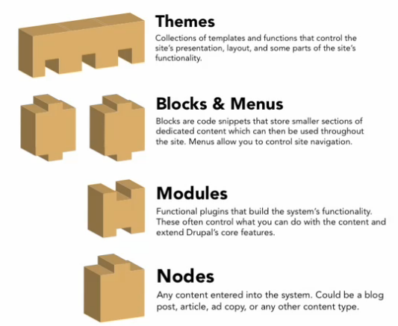
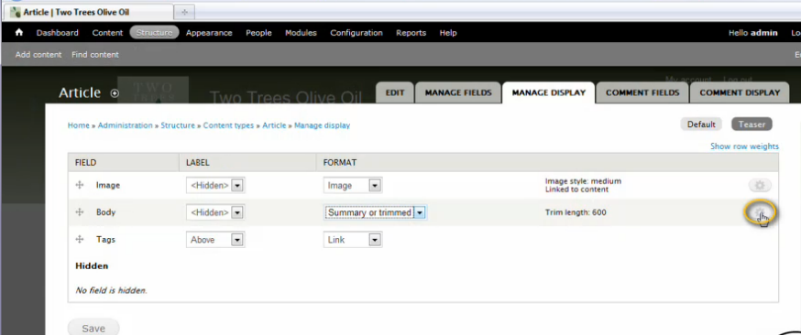
Content Management Systems
Drupal
More of a framework
Modular workflow over architecture and functionality
Difficult to set-up
Thus not ideal for smaller sites but large complex
http://ardorbacklinks.com/links/features-of-a-user-friendly-cms.html
Notes:
Available since 1996, but browser support was not there. With advent of CSS 2.0, and IE 6 Netsape 6+ Opera 6+), it has been more practical to use style sheets.

Slide 11
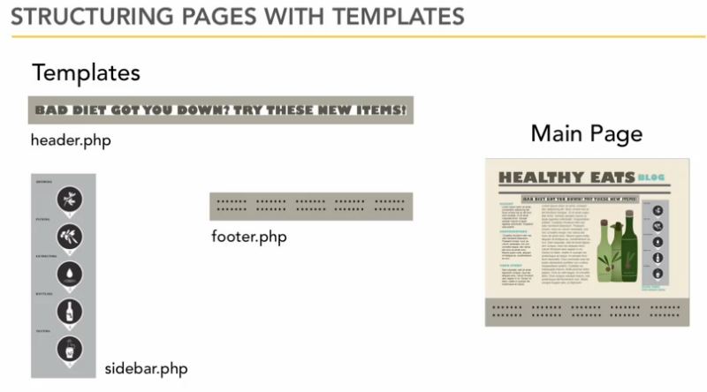
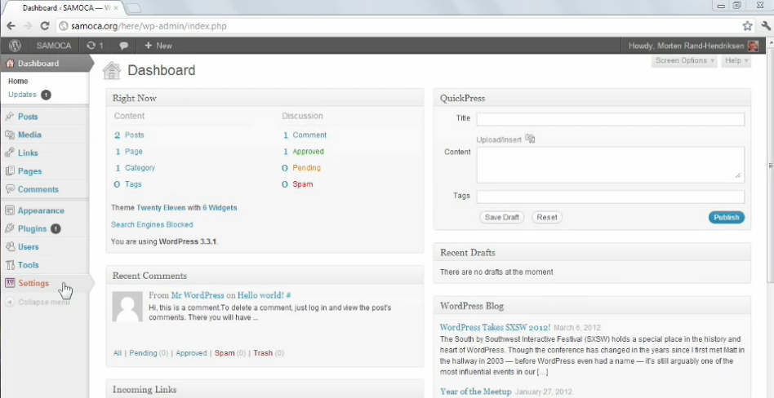
Content Management Systems
Uses themes to control page layout
Themes are collection of templates, functions, CSS
Takes a lot of technical skill
But using an existing theme is easy
Easy for users: hundreds of themes available
Active community for support
But non-blog oriented sites can be frustrating.
http://ardorbacklinks.com/links/features-of-a-user-friendly-cms.html
Notes:
Available since 1996, but browser support was not there. With advent of CSS 2.0, and IE 6 Netsape 6+ Opera 6+), it has been more practical to use style sheets.

Slide 12
Content Management Systems
Benefits for Different Roles:
Maintainers:
Ease of maintaining site with little knowledge.
Accessibility through browser– no need for a DW copy on their system.
Cannot edit all parts of a page thus less worry if you do something wrong– controlled by Admin
Admin:
Accountability.
Control page admin- user accounts, access rights
Provide access to several users for same page
**Changes to website are tracked
Standardization – maintain consistency across pages as access is restricted (similar to templates in DW)
Maintainers
Admin
Web Developers resist CMS:
Speed: CMS is slow
Flexibility: Limited tool support
Job Security: CMS becomes efficient thus less web developers needed.
Notes:
Available since 1996, but browser support was not there. With advent of CSS 2.0, and IE 6 Netsape 6+ Opera 6+), it has been more practical to use style sheets.

Slide 13
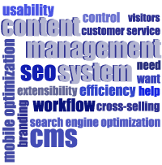
Content Management Systems
CMS Advantages:
Cost:
Some are free (Drupal, Joomla, WordPress)
Others based on size subscriptions but cost deflected because you don’t hire full-time developers to maintain
Easy customization:
A universal layout is created – similar theme and design
Easy to Use:
Designed for non-technical people
Simple to use for maintainer but limited in features
Access online via browser
Workflow Management:
Can control how content is published and when it is published, and who can publish.
Good for SEO
Freshness of content
Use of social media using your blog.
RSS feed which are automatically generated by blogs or CMS websites increase the # of subscribers and readers to your site.
invites external contribution (e.g. comments, forum, likes etc…), an integral component in staying relevant and improving your search engine ranking.
Notes:
Available since 1996, but browser support was not there. With advent of CSS 2.0, and IE 6 Netsape 6+ Opera 6+), it has been more practical to use style sheets.

Slide 14
Content Management Systems
CMS Disadvantages:
Cost:
Larger scale implementations require: training, planning and certifications
Some CMS may require hardware installations
Training, developing and upkeep
Cost of Maintenance:
License updates, upgrades, and hardware maintenance
Latency Issues:
Can experience latency if hardware infrastructure is not up to date; databases not being used correctly; web cache files have to be reloaded every time
Maintainer is restricted is restricted for creativity as they stick to very little choices.
Notes:
Available since 1996, but browser support was not there. With advent of CSS 2.0, and IE 6 Netsape 6+ Opera 6+), it has been more practical to use style sheets.

Slide 15

The World of Wikis
http://starwars.wikia.com/wiki/Main_Page
Wiki
pools together knowledge
Sum of knowledge = best resource

Slide 16
Wikis
Content Management Systems
Ability to Create, Edit and Publish web content
Wiki
Means “quick” in Hawaiian
Simplest collaborative CMS
A Web site developed collaboratively by a community of users
Allowing any user to add, remove, and edit content.
Multiple people work on a single piece of content
1 article → Many author
Blog
Simplest CMS on the web
any user to add and edit content.
A blog usually has one author (May have collaborative efforts of multiple bloggers,
1 article → 1 author

Slide 17
Wikis
Wiki
Simplest collaborative CMS
pools together knowledge
Sum of knowledge = best resource
Wikis in Plain English
http://www.youtube.com/watch?v=-dnL00TdmLY
Anybody can contribute to a wiki
Realtime system

Slide 18

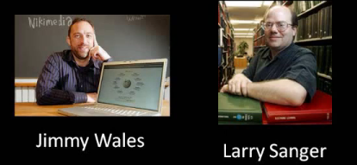
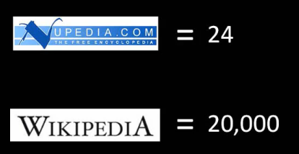
Wikis
History of Wikis
1994 – WikiWikiWeb
Developed by Ward Cunningham
Ward Cunningham
Watch video clip
http://www.youtube.com/watch?v=oVFPW0r4jWk&feature=endscreen&NR=1
Mar 2000 - 2003
Jimmy Wales and Larry Sanger
Revolutionized how people collaborated
Goal: create a free online encyclopedia to rival MS Encarta and Britannica → Nupedia born!
Too many restrictions for its failure:
Article – strict peer review process before publication
Contributors: Article authors had to be experts with a PHD
Wikipedia Jan 2001 launched
A discussion forum where public could suggest/edit content to nupedia.
Anyone could discuss and contribute
Abandoned nupedia... And thus Wikipedia was born
Wikipedia Today:
Contributions, Maintenance from volunteer staff...
Funded by donations by public
5 million articles in total (all languages)
Top 50 websites.. More popular than New York Times
18M registered users Incl. 1450 administrators
http://en.wikipedia.org/wiki/Wikipedia:About

Slide 19
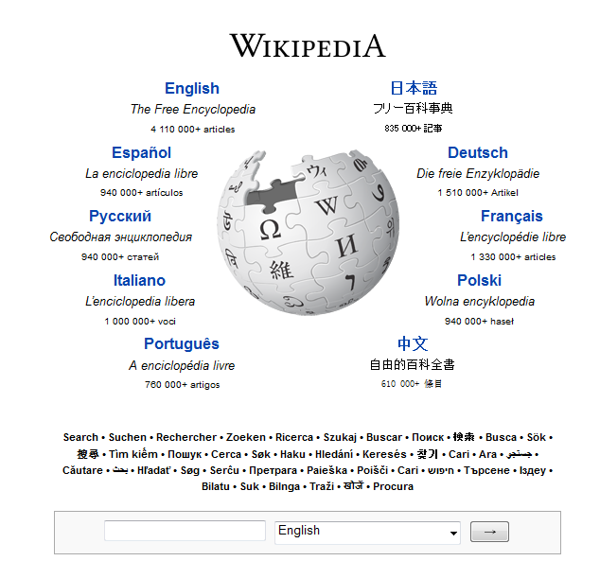
Wikis
Wikipidia
Largest Wiki on the web (owned by Wikimedia Foundation – Jimmy Wales)
Written with wiki software
Free licensed online biggest encyclopedia
Share expertise about writing about it
Multilingual web based free content
(published articles in more than 250 languages
Overview of Wikipedia http://www.youtube.com/watch?NR=1&v=Au6a1Qq92Ug&feature=endscreen
Wikimedia Foundation
Mission:
Give free encyclopedia to every person on the planet
Empower people to have information to make good decisions
Thus free licensing model → Gives opportunities to contribute
If you want to watch it on your own.. Jimmy Wales explaining Wikipedia (20 min)
http://www.youtube.com/watch?v=WQR0gx0QBZ4

Slide 20
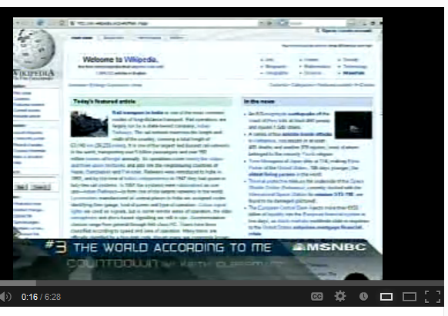
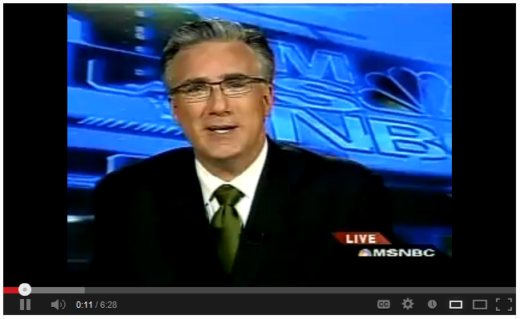
Wikis
Wikipidia
Can things go Wrong?
Authenticity of articles
Author’s reputation – expertise
Accuracy: spelling, grammar
Vandalism from anonymous
See how things can go wrong http://www.youtube.com/watch?v=i5sO7S2RMf4 (watch about 3 min)
How Wikipedia deals with
Have tools to monitor changes and track changes
Tools to compute reputation and trust in real-time as edits are made
But there are editor who edit the language, grammar, rewrite so easy to read

Slide 21
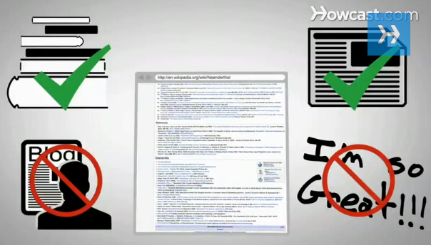
Wikis
Wikipedia
Want to Contribute? Before you get started
Internet access, reliable sources, notable topic
Wikipedia wants unbiased, well sourced subjects
Notability guidelines: significant coverage in reliable sources
Must follow the rules otherwise could be deleted
Will not publish
Publicizing or promoting a business.
Advice legal or medical.
Instructional material.
Personal essays
How to Add and Article:
Great video on how to add an article to wikipedia
http://www.youtube.com/watch?v=1CwiZIsaM7s (3.5 min)
Select your topic
Get ideas for topics WP:RA in Search box
Make sure reliable source: News source (yes) , bloggers (no)
Find out if wikipedia has already the topic
Search topic on google if wikipedia shows up
Becomes a registered user with an account
If not registered, then Submit a proposal through Wikipedia’s Articles for Creation
Practice writing an article in Sandbox
Proof it and publish it.

Slide 22
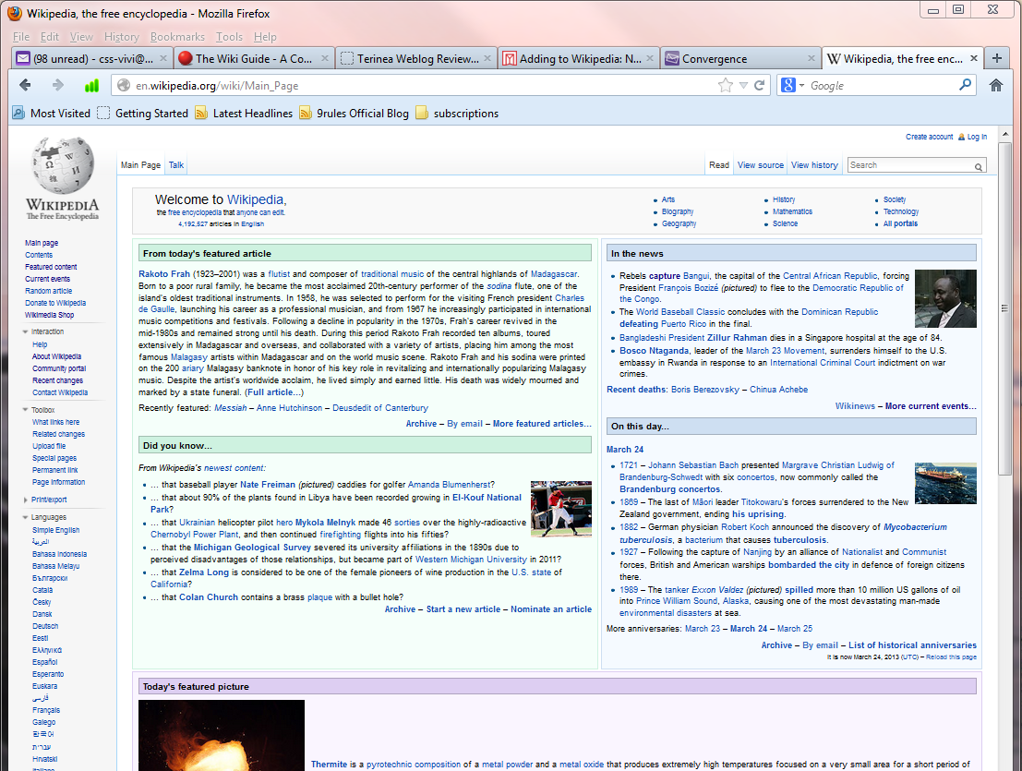

Slide 23
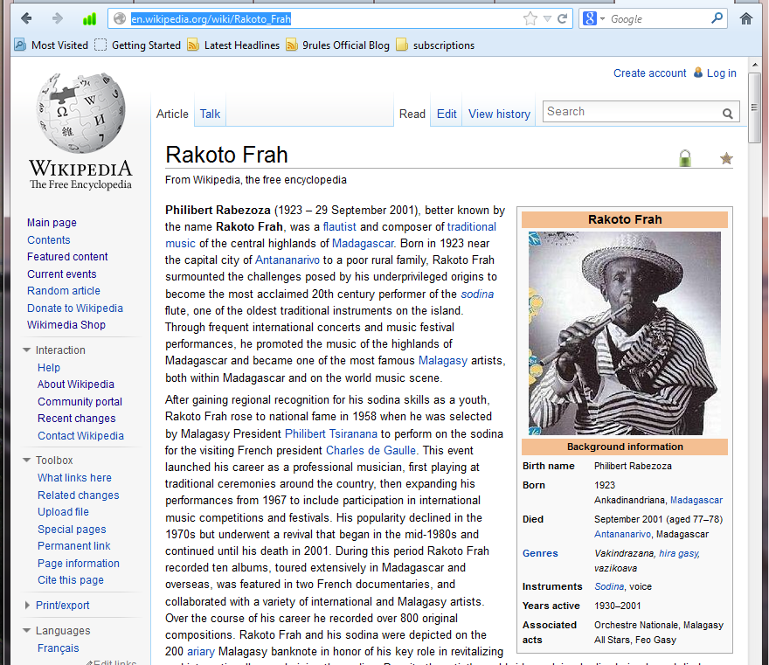
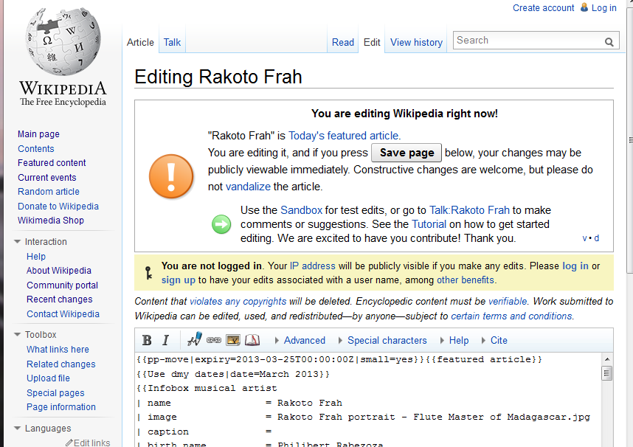
http://en.wikipedia.org/wiki/Western_University_of_London,_Ontario
University of Western Ontario needs editing on Wikipedia

Slide 24

Wikis
Companies can start their Wiki
Why?
“Who do I call to order more bubble wrap?”
“Which restaurant did we take the client to last time? Did she like it?”
“Who are our major competitors in Latin America?”
Everyone in your business knows something. We each have our own little silos of knowledge, which, when put together, make up our company's institutional memory.
Build a corporate _________ repository
___________ the knowledge before someone leaves
Easily accessible and up to date -_____________
Sharing of information online and _________ (everybody can contribute and edit)
How do I set up a company wiki?
Setup a private internal wiki on your ________
________ it to an online wiki provider ($$$ or free
See this handy Wiki Software Wizard to help you find the right one for you http://www.wikimatrix.org/ (click on Choice Wizard)
FACTS:
IBM currently runs 56,000 internal wikis, which generate over a million page views/day
Western ITS - (Kiwi)
OWL has a wiki if enabled
Bloomfire BrainKeeper
MediaWiki
TikiWiki
DokuWiki

Slide 25
Wikis
And that’s the whole story on CMS and Wikis
Western does have a wiki called “kiwi”
OWL has the functionality of wiki as well.
Next lecture and the last!!
E-commerce and some Review Notes handed out

